Slide 1
Universal Viewer
IIIF: Access to the World's Images – New York 2016
Tom Crane
Technical Director, Digirati
http://digirati.com/

Slide 2
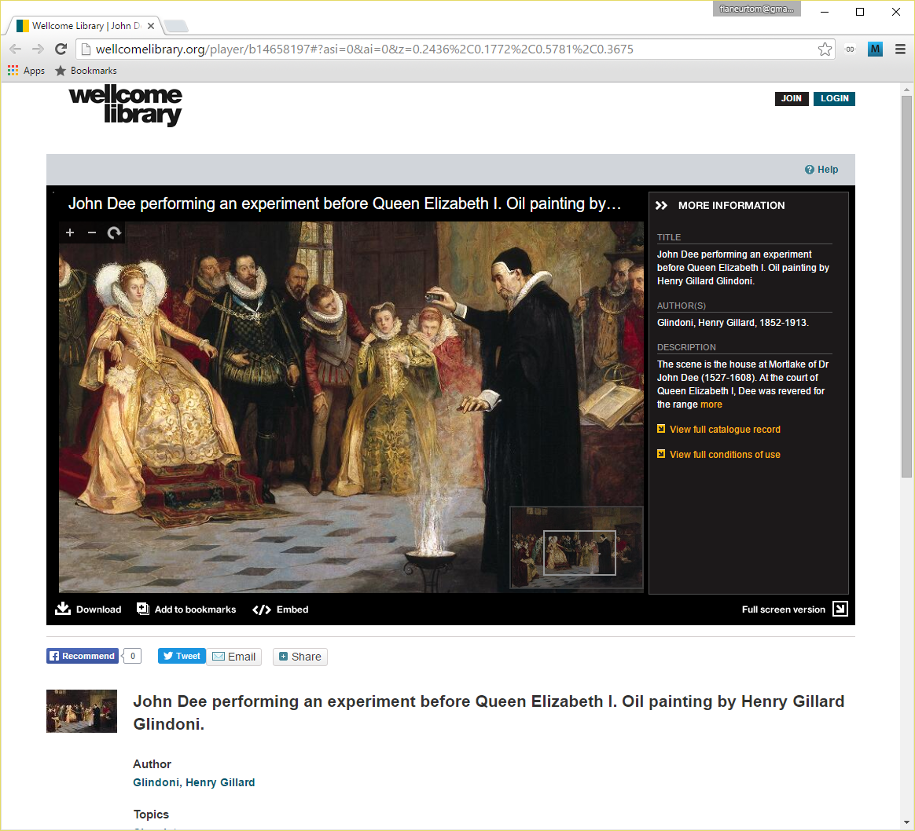
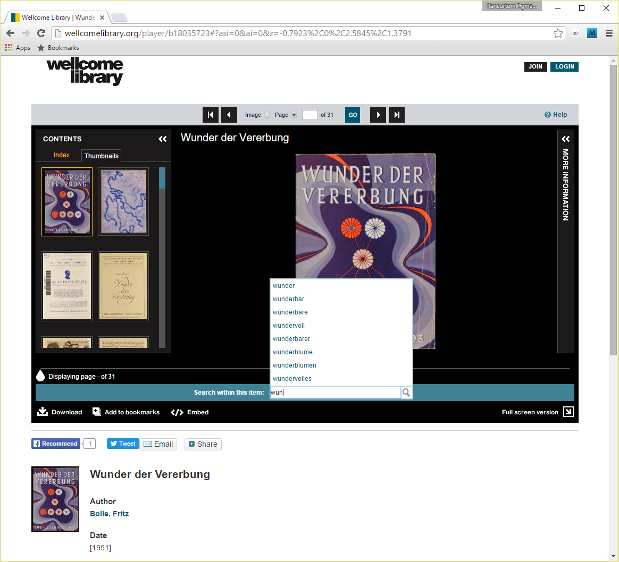
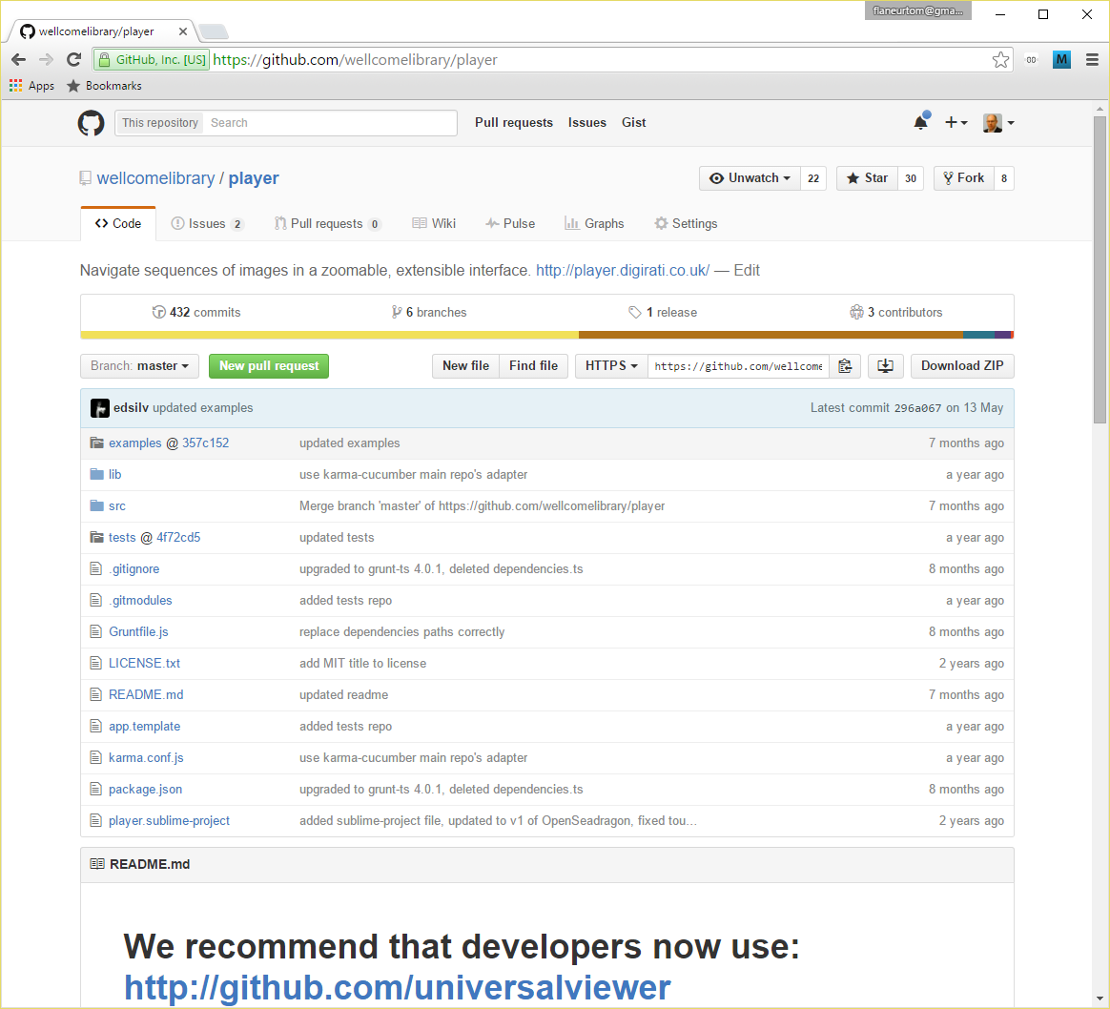
“Player”
Notes:
A silo – a nice silo, but still a silo.

Slide 3
IIIF-isation
British Library choose the Wellcome Player as the starting point of their "Universal Viewer" project
British Library are founding contributors to IIIF
The Universal Viewer is born

Slide 4
Contributors and Users

Slide 5
Demo…
http://goo.gl/SBqnee

Slide 6
Paging and 2-up

Slide 7
Thumbs

Slide 8
More Information (metadata, rights, license)

Slide 9
IIIF Search API – Autocomplete and Search

Slide 10
Download - current

Slide 11
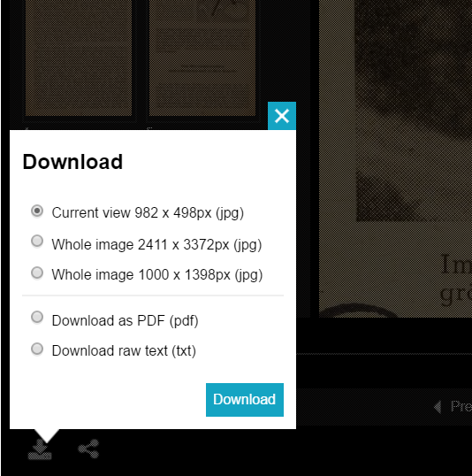
Download – other sizes and renderings

Slide 12
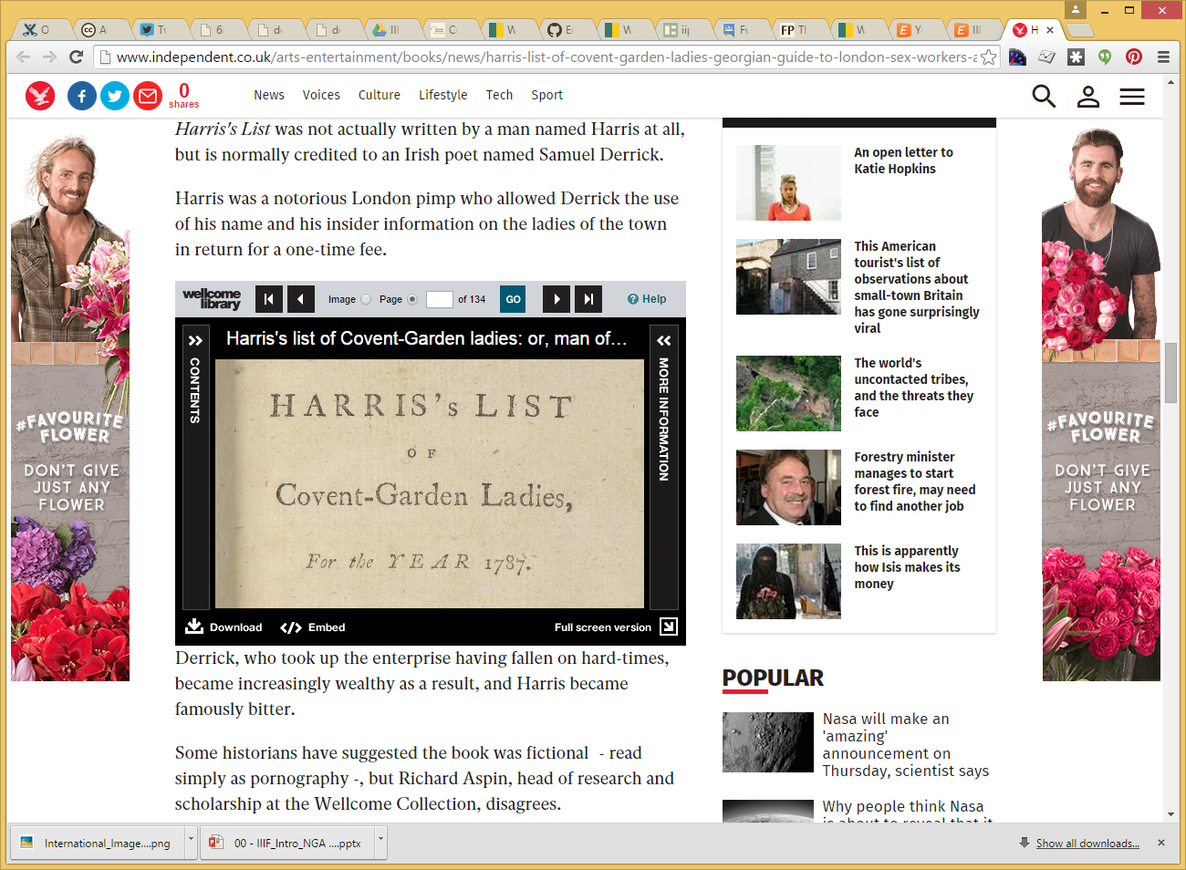
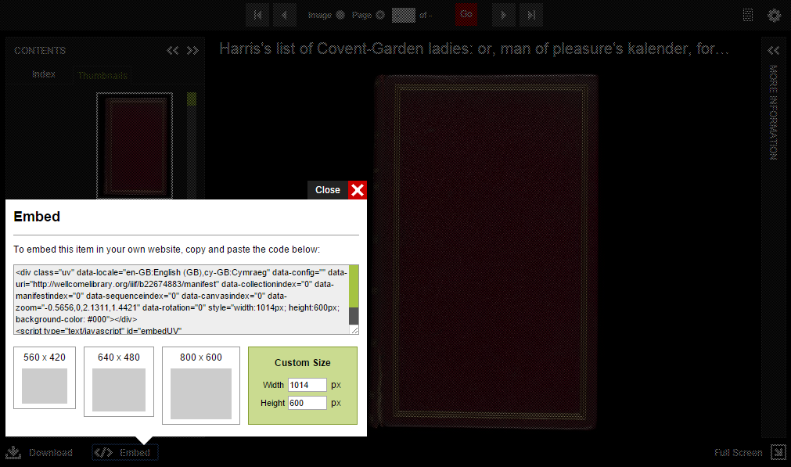
Embed

Slide 13
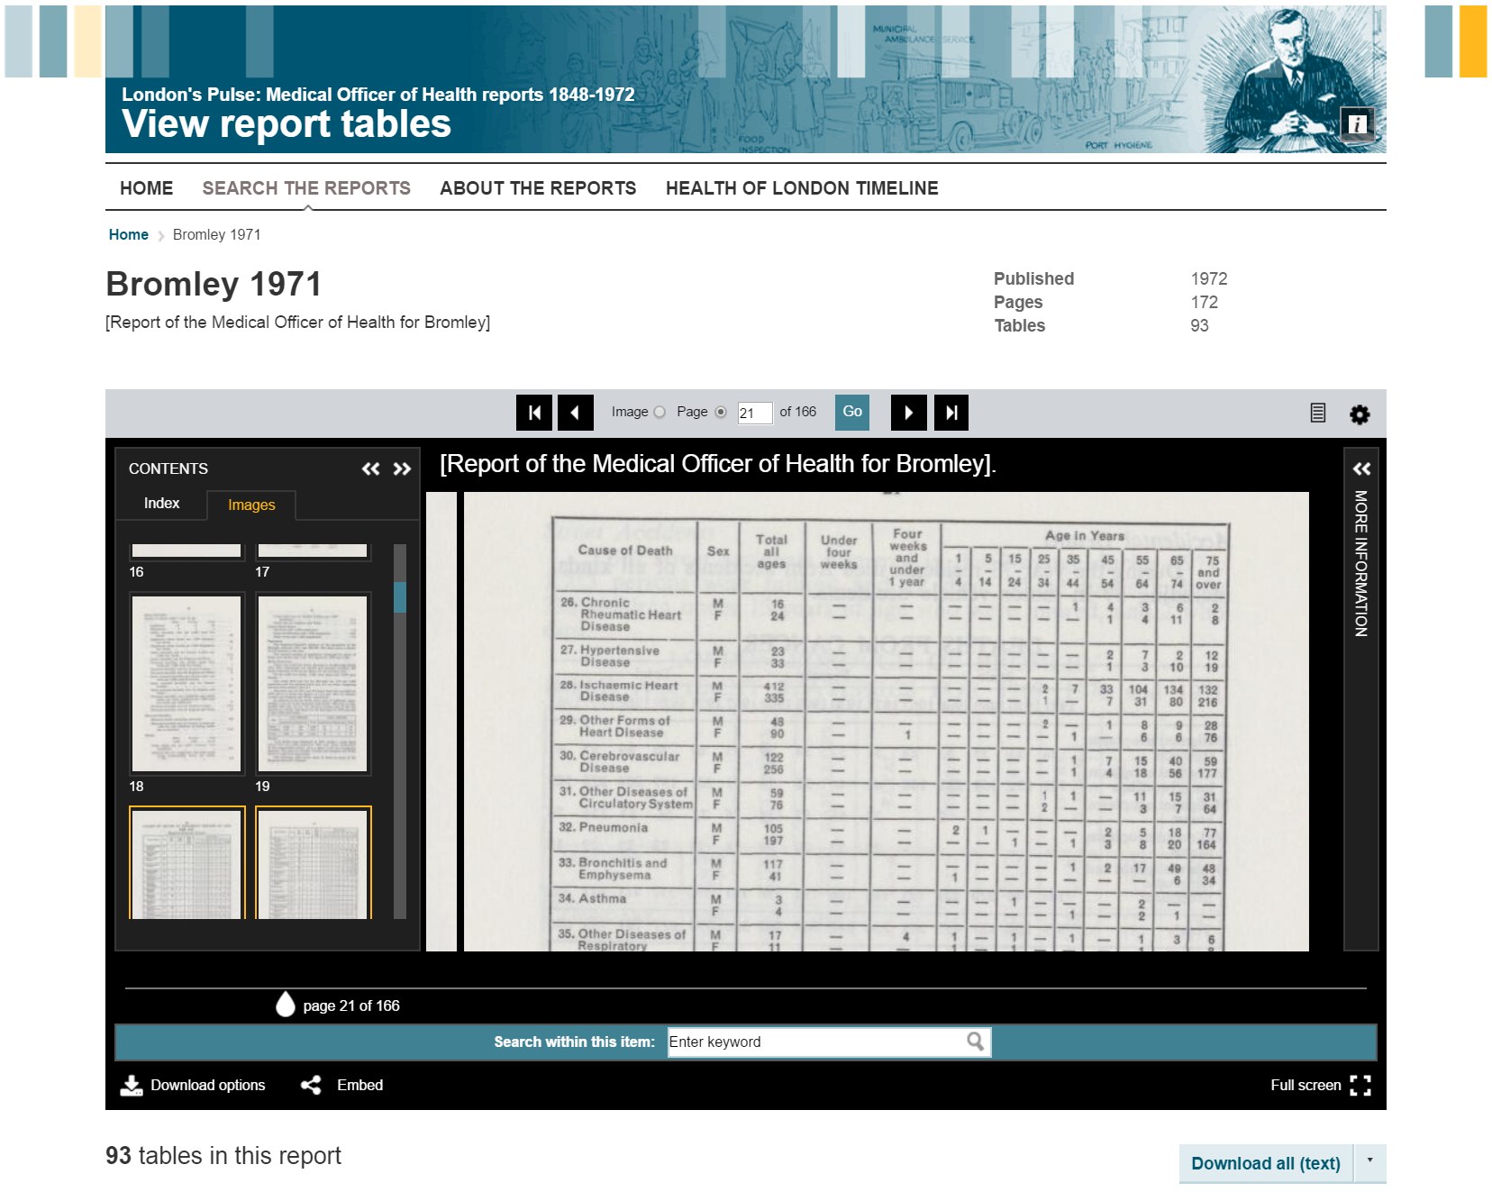
Themes

Slide 14
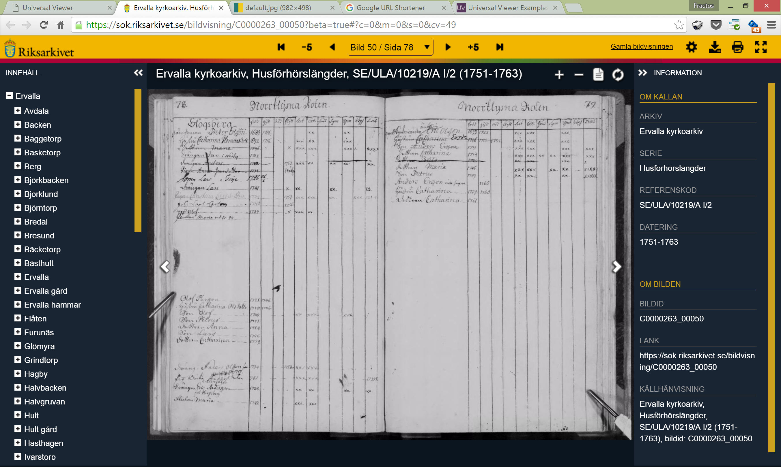

Slide 15
Click-through authentication

Slide 16
Regular authentication

Slide 17
IIIF Collections – multi volume

Slide 18
IIIF Collections – 6500 manifests with dates

Slide 19
Right to left

Slide 20
Top to bottom

Slide 21
Continuous

Slide 22
Other media
Before we could replace the Wellcome Player with the Universal Viewer, it not only had to support authentication and “search within”, but it had to play audio, video and born-digital material.
For now, just play the material.
Interim “IxIF” model until community process produces models for time-based media and 3D

Slide 23
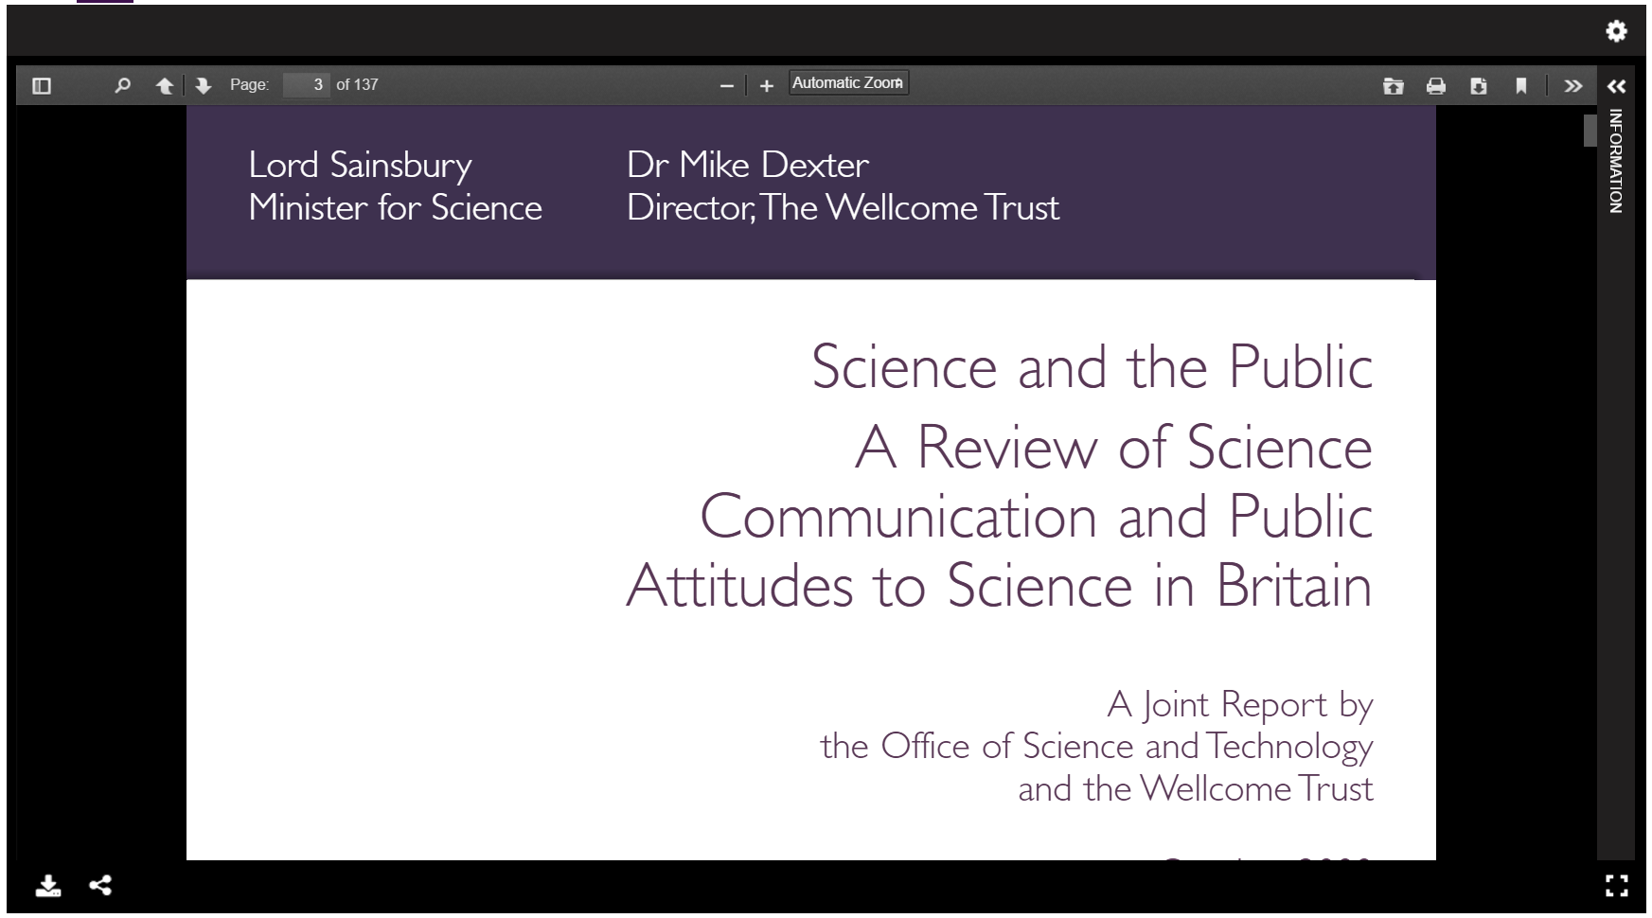
PDFs

Slide 24
Video

Slide 25
3D

Slide 26
Thank you
https://github.com/UniversalViewer/universalviewer
http://universalviewer.io/examples
http://digirati.com/iiif
Tom Crane
Technical Director, Digirati
http://digirati.com/
tom.crane@digirati.com

